Slide 1
Train Length
With thanks to David Jeys,
The Manchester Grammar School
(Note to MGS staff: this resource is related to Year 10 Problem Solving tasks no. 11)

Slide 2


Train Length
Not to scale
The full length of a train takes 10 seconds to pass a signal and 30 seconds to completely pass through a tunnel 560 metres long.
What is the length of the train?

Slide 3
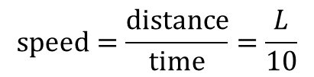



Train Length
The full length of a train takes 10 seconds to pass a signal and 30 seconds to completely pass through a tunnel 560 metres long.
$t=0$ seconds
$L$ metres
$t=10$ seconds
$$speed=\frac{distance}{time}=\frac{L}{10}$$

Slide 4




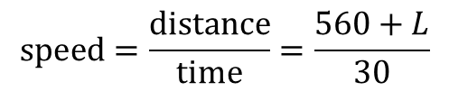
Train Length
The full length of a train takes 10 seconds to pass a signal and 30 seconds to completely pass through a tunnel 560 metres long.
$t=0$ seconds
$560$ metres
$L$ metres
$t=30$ seconds
$$speed=\frac{distance}{time}=\frac{560+L}{30}$$

Slide 5
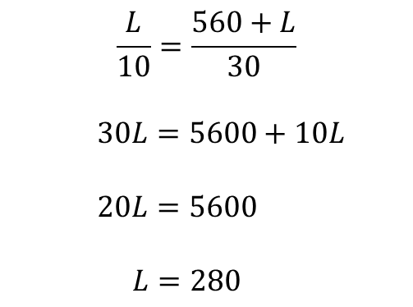
Train Length
The full length of a train takes 10 seconds to pass a signal and 30 seconds to completely pass through a tunnel 560 metres long.
$$\frac{L}{10}=\frac{560+L}{30}$$
$30L=5600+10L$
$20L=5600$
$L=280$
The length of the train is 280 metres.

Slide 6




Train Length
$W$ metres
$L$ metres
Time to pass signal $= t_{1}$ seconds
Time to pass through tunnel $= t_{2}$ seconds
The length of the train is half the length of the tunnel for all worksheets.
Why is this?

Slide 7

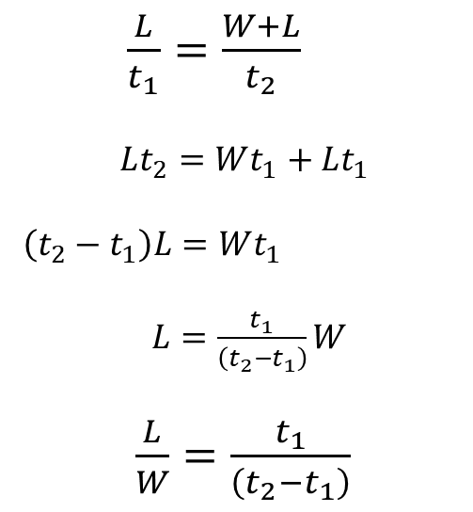
Train Length
$W$ metres
$L$ metres
Time to pass signal $= t_{1}$ seconds
Time to pass through tunnel $= t_{2}$ seconds
$\frac{L}{t_{1}}=\frac{W+L}{t_{2}}$
$Lt_{2}=Wt_{1}+Lt_{1}$
$\left(t_{2}−t_{1}\right)L=Wt_{1}$
$L=\frac{t_{1}}{\left(t_{2}−t_{1}\right)}W$
$\frac{L}{W}=\frac{t_{1}}{\left(t_{2}−t_{1}\right)}$
$\frac{1}{2}=\frac{t_{1}}{\left(t_{2}−t_{1}\right)}$
$t_{2}−t_{1}=2t_{1}$
$t_{2}=3t_{1}$
$\frac{t_{2}}{t_{1}}=3$

Slide 9
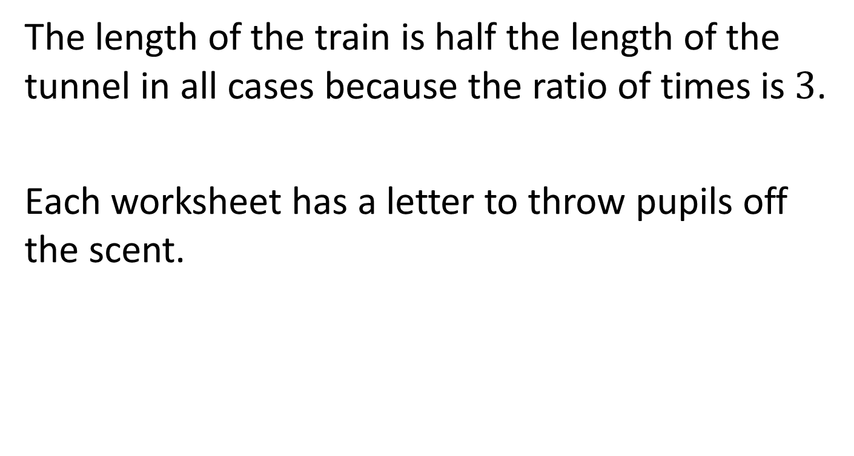
Note to Teacher
The length of the train is half the length of the tunnel in all cases because the ratio of times is $3$.
Each worksheet has a letter to throw pupils off the scent.

Slide 10
RESOURCES

Slide 11
Train Length
SIC_68
Not to scale
The full length of a train takes 15 seconds to pass a signal and 45 seconds to completely pass through a tunnel 540 metres long.
What is the length of the train?
A

Slide 12
Train Length
SIC_68
Not to scale
The full length of a train takes 16 seconds to pass a signal and 48 seconds to completely pass through a tunnel 580 metres long.
What is the length of the train?
B

Slide 13
Train Length
SIC_68
Not to scale
The full length of a train takes 17 seconds to pass a signal and 51 seconds to completely pass through a tunnel 560 metres long.
What is the length of the train?
C

Slide 14
Train Length
SIC_68
Not to scale
The full length of a train takes 14 seconds to pass a signal and 42 seconds to completely pass through a tunnel 480 metres long.
What is the length of the train?
D

Slide 15
Train Length
SIC_68
Not to scale
The full length of a train takes 13 seconds to pass a signal and 39 seconds to completely pass through a tunnel 460 metres long.
What is the length of the train?
E

Slide 16
Train Length
SIC_68
Not to scale
The full length of a train takes 12 seconds to pass a signal and 36 seconds to completely pass through a tunnel 440 metres long.
What is the length of the train?
F

Slide 17
Train Length
SIC_68
Not to scale
The full length of a train takes 11 seconds to pass a signal and 33 seconds to completely pass through a tunnel 420 metres long.
What is the length of the train?
G

Slide 18
Train Length
SIC_68
Not to scale
The full length of a train takes 18 seconds to pass a signal and 54 seconds to completely pass through a tunnel 720 metres long.
What is the length of the train?
H

Slide 19
Train Length
SIC_68
Not to scale
The full length of a train takes 15 seconds to pass a signal and 45 seconds to completely pass through a tunnel 680 metres long.
What is the length of the train?
I

Slide 20
Train Length
SIC_68
Not to scale
The full length of a train takes 16 seconds to pass a signal and 48 seconds to completely pass through a tunnel 660 metres long.
What is the length of the train?
J

Slide 21
Train Length
SIC_68
Not to scale
The full length of a train takes 17 seconds to pass a signal and 51 seconds to completely pass through a tunnel 880 metres long.
What is the length of the train?
K

Slide 22
Train Length
SIC_68
Not to scale
The full length of a train takes 14 seconds to pass a signal and 42 seconds to completely pass through a tunnel 780 metres long.
What is the length of the train?
L

Slide 23
Train Length
SIC_68
Not to scale
The full length of a train takes 13 seconds to pass a signal and 39 seconds to completely pass through a tunnel 1460 metres long.
What is the length of the train?
M

Slide 24
Train Length
SIC_68
Not to scale
The full length of a train takes 12 seconds to pass a signal and 36 seconds to completely pass through a tunnel 1040 metres long.
What is the length of the train?
N

Slide 25
Train Length
SIC_68
Not to scale
The full length of a train takes 11 seconds to pass a signal and 33 seconds to completely pass through a tunnel 660 metres long.
What is the length of the train?
O

Slide 26
Train Length
SIC_68
Not to scale
The full length of a train takes 18 seconds to pass a signal and 54 seconds to completely pass through a tunnel 1620 metres long.
What is the length of the train?
P

